Slide 1
Thực hành Lab1

Slide 2
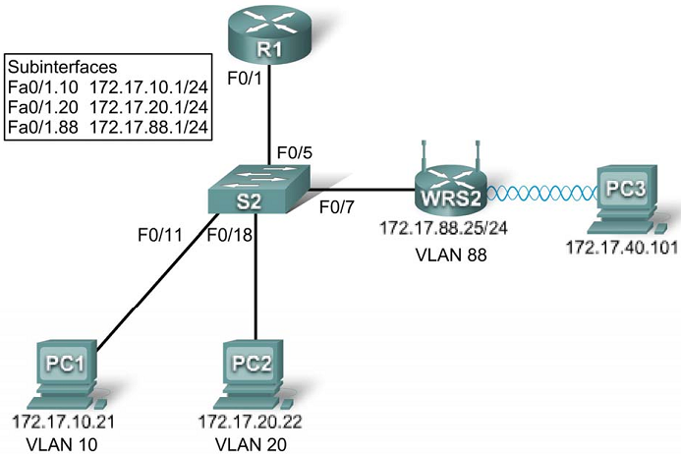
Topology Diagram

Slide 3
Task 1: Load the starting configurations.
Step 1. Load R1’s configurations.
hostname R1
!
interface FastEthernet0/0
ip address 172.17.50.1 255.255.255.0
no shutdown
!
interface FastEthernet0/1
no ip address
no shutdown
!
interface FastEthernet0/1.10
encapsulation dot1Q 10
ip address 172.17.10.1 255.255.255.0
!
interface FastEthernet0/1.20
encapsulation dot1Q 20
ip address 172.17.20.1 255.255.255.0
!
interface FastEthernet0/1.88
encapsulation dot1Q 88
ip address 172.17.88.1 255.255.255.0
!

Slide 4
Task 1: Load the starting configurations.
Step 2. Load S2’s configurations.
hostname S2
!
interface FastEthernet0/5
switchport trunk encapsulation dot1q
switchport mode trunk
no shutdown
!
interface FastEthernet0/7
switchport access vlan 88
switchport mode access
no shutdown
!
interface FastEthernet0/11
switchport access vlan 10
switchport mode access
no shutdown
!
interface FastEthernet0/18
switchport access vlan 20
switchport mode access
no shutdown

Slide 5
Task 2: Connect and log into the Wireless Router.
Step 1. Establish physically connectivity.
Step 2. Open a web browser.
Step 3. Navigate to the wireless router’s Web Utility.
Step 4. Log in

Slide 6
Task 3: Configure Options in the Linksys Setup Tab.
Step 1. Set the Internet connection type to static IP.
Step 2. Configure the VLAN 88 IP address, subnet mask, and default gateway for WRS2.
Set the Internet IP address to 172.17.88.25.
Set the subnet mask to 255.255.255.0.
Set the default gateway to 172.17.88.1.
Step 3. Configure the router IP parameters.

Slide 7
Task 3: Configure Options in the Linksys Setup Tab.
Still on this page, scroll down to Network Setup. For the Router IPfields do the following:
Set the IP address to 172.17.40.1 and the subnet mask to 255.255.255.0.
Under the DHCP Server Setting, ensure that the DHCP server is enabled.
Step 4. Save settings.
Step 5. Reconnect to WRS2.

Slide 8
Task 4: Configure Options in the Linksys Wireless Tab.
Step 1. Set the network name (SSID).
Click the Wirelesstab.
Under Network Name (SSID), rename the network from Defaultto WRS_LAN.
Click Save Settings.
Step 2. Set the security mode.
Click Wireless Security. It is located next to Basic Wireless Settingsin the main Wireless tab.
Change Security Mode from Disabled to WEP.
Using the default Encryption of 40/64-Bit, set Key1to 1234567890,
Click Save Settings.

Slide 9
Task 5: Configure Options in the Linksys Administration Tab
Step 1. Set the router password.
Click the Administration tab.
Under Router Access, change the router password to cisco123. Re-enter the same password to confirm.
Step 2. Enable remote management.
Under Remote Access, enable remote management.
Click Save Settings.
You may be prompted to log in again. Use the new password of cisco123and still keep the username blank

Slide 10
Task 6: Configure Options in the Linksys Security Tab
Step 1. Allow anonymous internet requests.
Click the Security Tab
Under Internet Filter, uncheck Filter Anonymous Internet Requests.

Slide 11
Task 7: Add Wireless Connectivity to a PC
Step 1. Disconnect the Ethernet connection from PC3 to WRS2.
Step 2: Use Windows to connect to the wireless router.
Step 3: Verify the Connection.

Slide 12
Task 8: Test Connectivity
Step 1. Ping WRS2’s LAN/Wireless interface.
On PC3, click Start->Run
Type cmdand select open. This will open the command prompt
In the command prompt type (without quotes) “ping 172.17.40.1”.

Slide 13
Task 8: Test Connectivity
Step 2. Ping R1’s Fa0/1.88 Interface.
In the command prompt type (without quotes) “ping 172.17.88.1”
Step 3. Ping PC1 and PC2 from PC3.
In the command prompt type (without quotes) “ping 172.17.10.21” to ping PC1.
Repeat on PC2’s address, 172.17.20.22.

